Slide 1
CryptoLight
A lightweight cryptography module for Python

Slide 2
Motivation
Internet of Things technology increasing in prevalence
IoT systems are often time and safety critical
Smart homes, autonomous vehicles, medical technology
Traditional Internet security mechanisms do not apply
Often far too computationally taxing for constrained devices

Slide 3
Introducing Simon and Speck
Lightweight cryptography algorithms created by the NSA in 2011
Simon
Optimized for software constrained devices
Low RAM, processing power
Encryption algorithm built around bitwise AND
Speck
Optimized for hardware constrained devices
Low silicone footprint, power
Encryption algorithm build around module addition

Slide 4
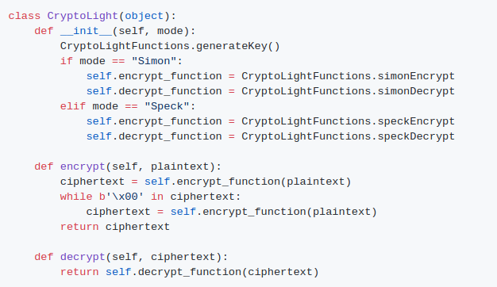
Design: the OOP interface

Slide 5
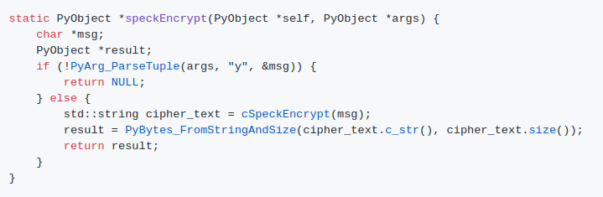
Implementation: translation
Middle man function for turning Python arguments into C data types

Slide 6
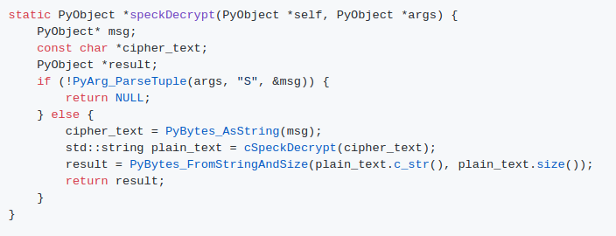
Middle man function for translating C data types to Python objects

Slide 7
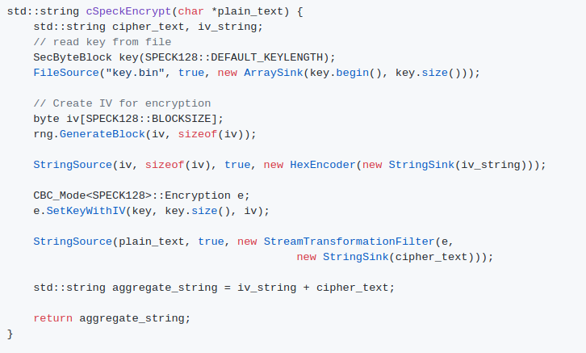
Implementation: Encryption

Slide 8
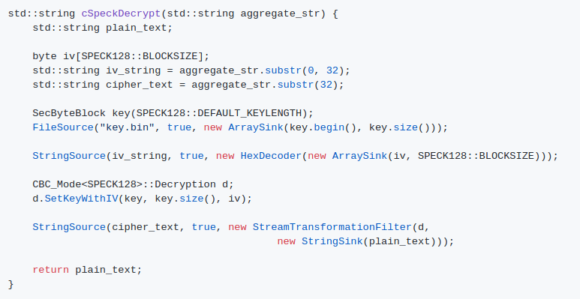
Implementation: Decryption

Slide 9
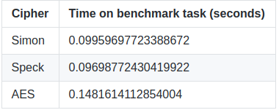
Performance
Benchmarked against 200 kB of text data
Run against AES to see how they compare to a traditional block cipher

Slide 10
Retrospective
Set out to learn about cryptography modules
Ended up learning much more about how the Python interpreter works
I would recommend this project to people who are interested in learning more about how Python works, not to people interested in cryptography
If you are interested in cryptography, just stick with C++

